Slide 1
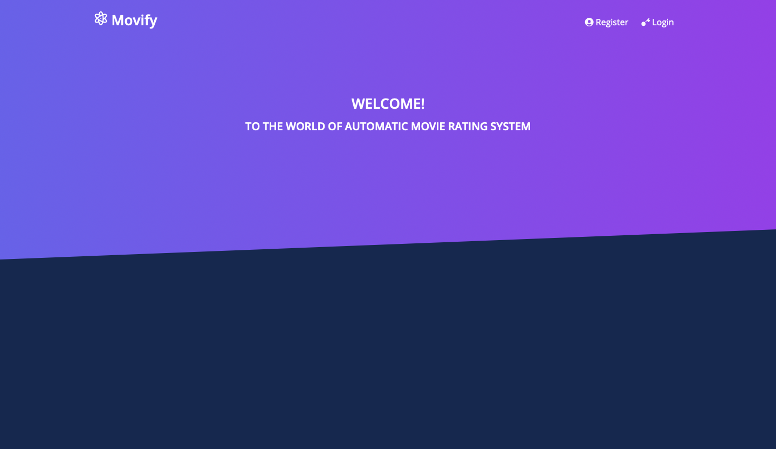
Movify - An Automated Movie Rating System
- By Team 4

Slide 2
To create a Movie Rating System that automatically analyze the user opinions from social media using natural language processing and machine learning.
Objective

Slide 3
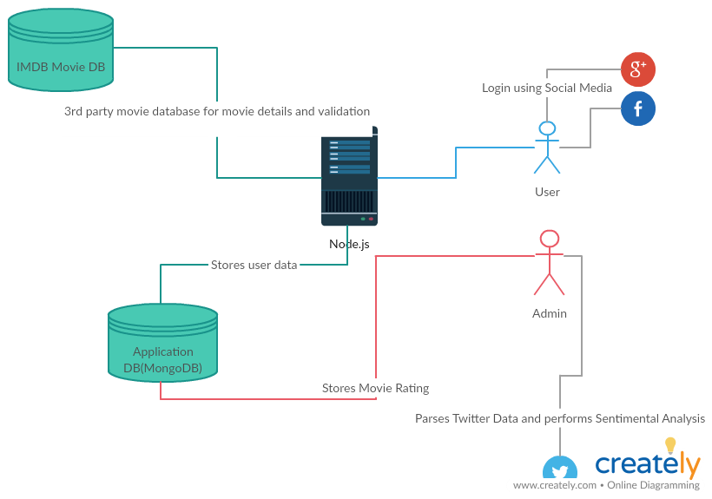
System Architecture

Slide 4
Angular CLI Twitter API – Social Media Data Python – Backend Development MongoDB Database – For Storing/Processing Data TextBlob and Vader – A python library for sentimental analysis Tweepy – A python library for Twitter API
Technologies

Slide 5
Login: Users can login into the system by Social Media Plugins. Search: User can search the movie and can view the ratings, synopsis and castings. Sentimental Analysis : The system would calculate the ratings based on the sentimental analysis which internally uses Natural Language Processing. Dashboard: Users would be able to view the top rated ten movies.
System Features

Slide 6
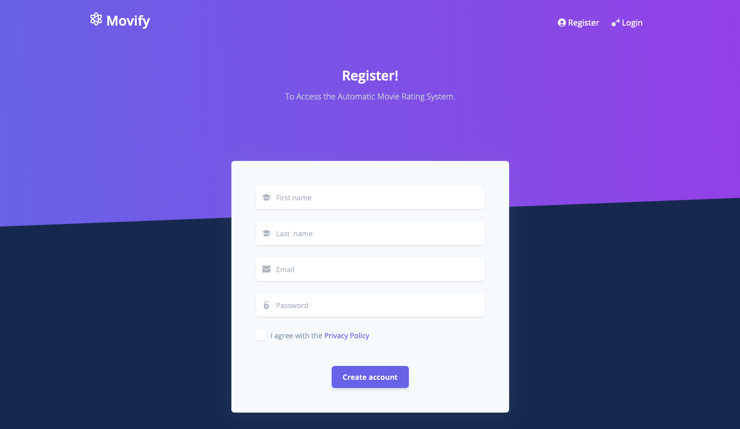

Slide 7
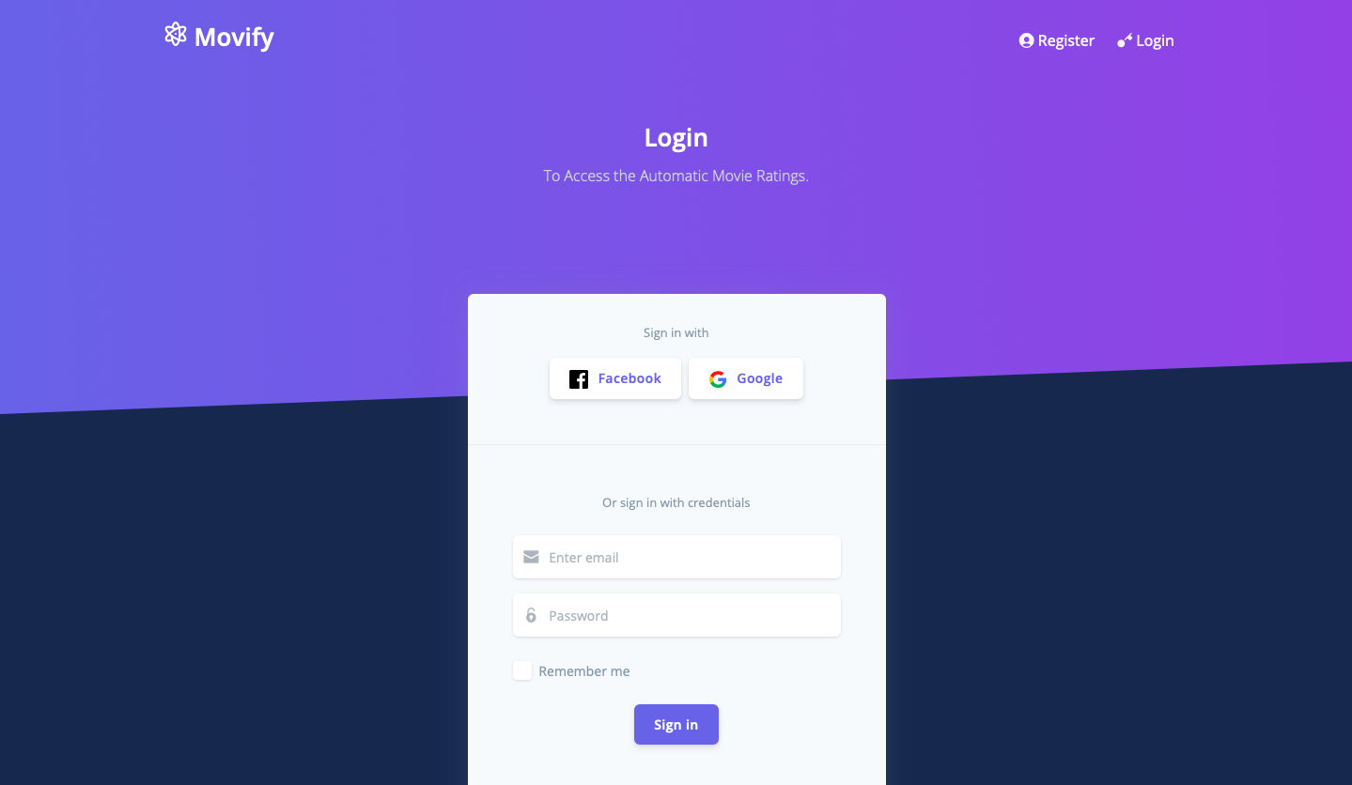

Slide 8
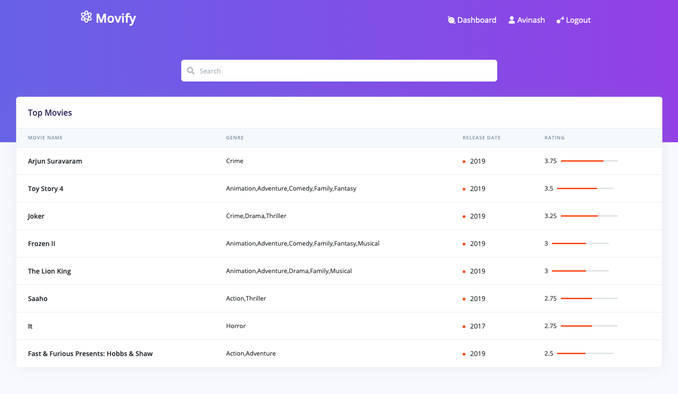

Slide 9
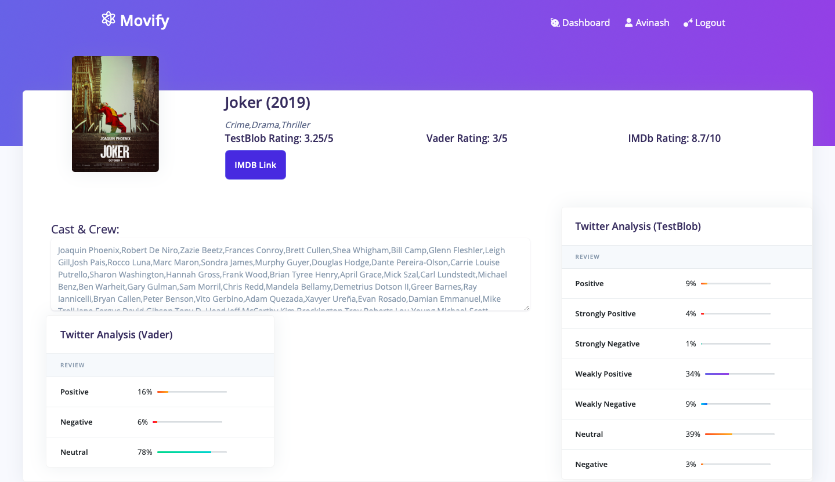

Slide 10
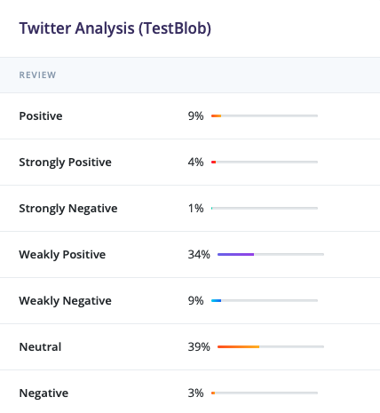
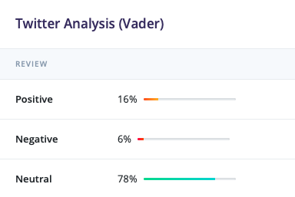

Slide 11
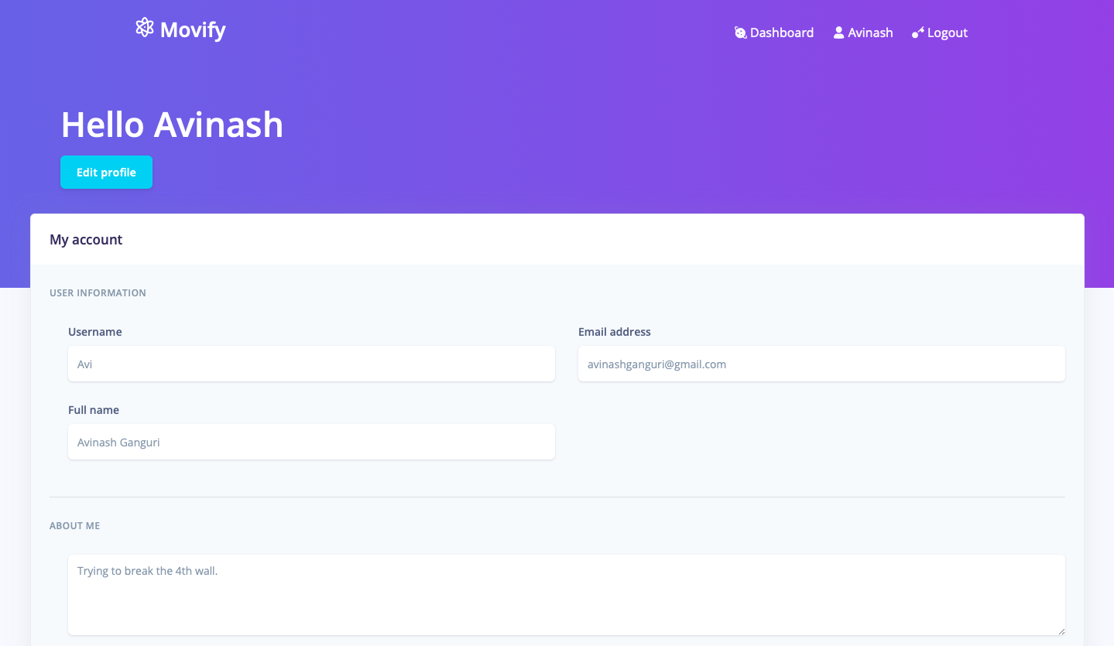

Slide 12
https://youtube.com https://kaggle.com https://tutorialpoints.com https://stackoverflow.com
References

Slide 13
Movify – An Automated Movie Rating System
The work has been completed under the guidance of Dr. Yugi Lee, Vijay Walunj, and TAs
(Sirisha Rella, Gaikwad, Priyanka)
CS5551 Advanced Software Engineering,
University of Missouri - Kansas City),
Fall 2019

Slide 14
Avinash Ganguri - 7 Sri sai Nikhil kantipudi - 9 jai sekhar koya - 13 Chaitanya mallepudi - 16
Team Members

Slide 15
Thank YOU

